Slide 1


BagBlock:
Luggage Lost?
Blockchain Found.
Anisa Stavri, Leon Tash, Natalia Shuniakova, Daniel Lorenzo, Elizaveta Kuchkarova

Slide 2

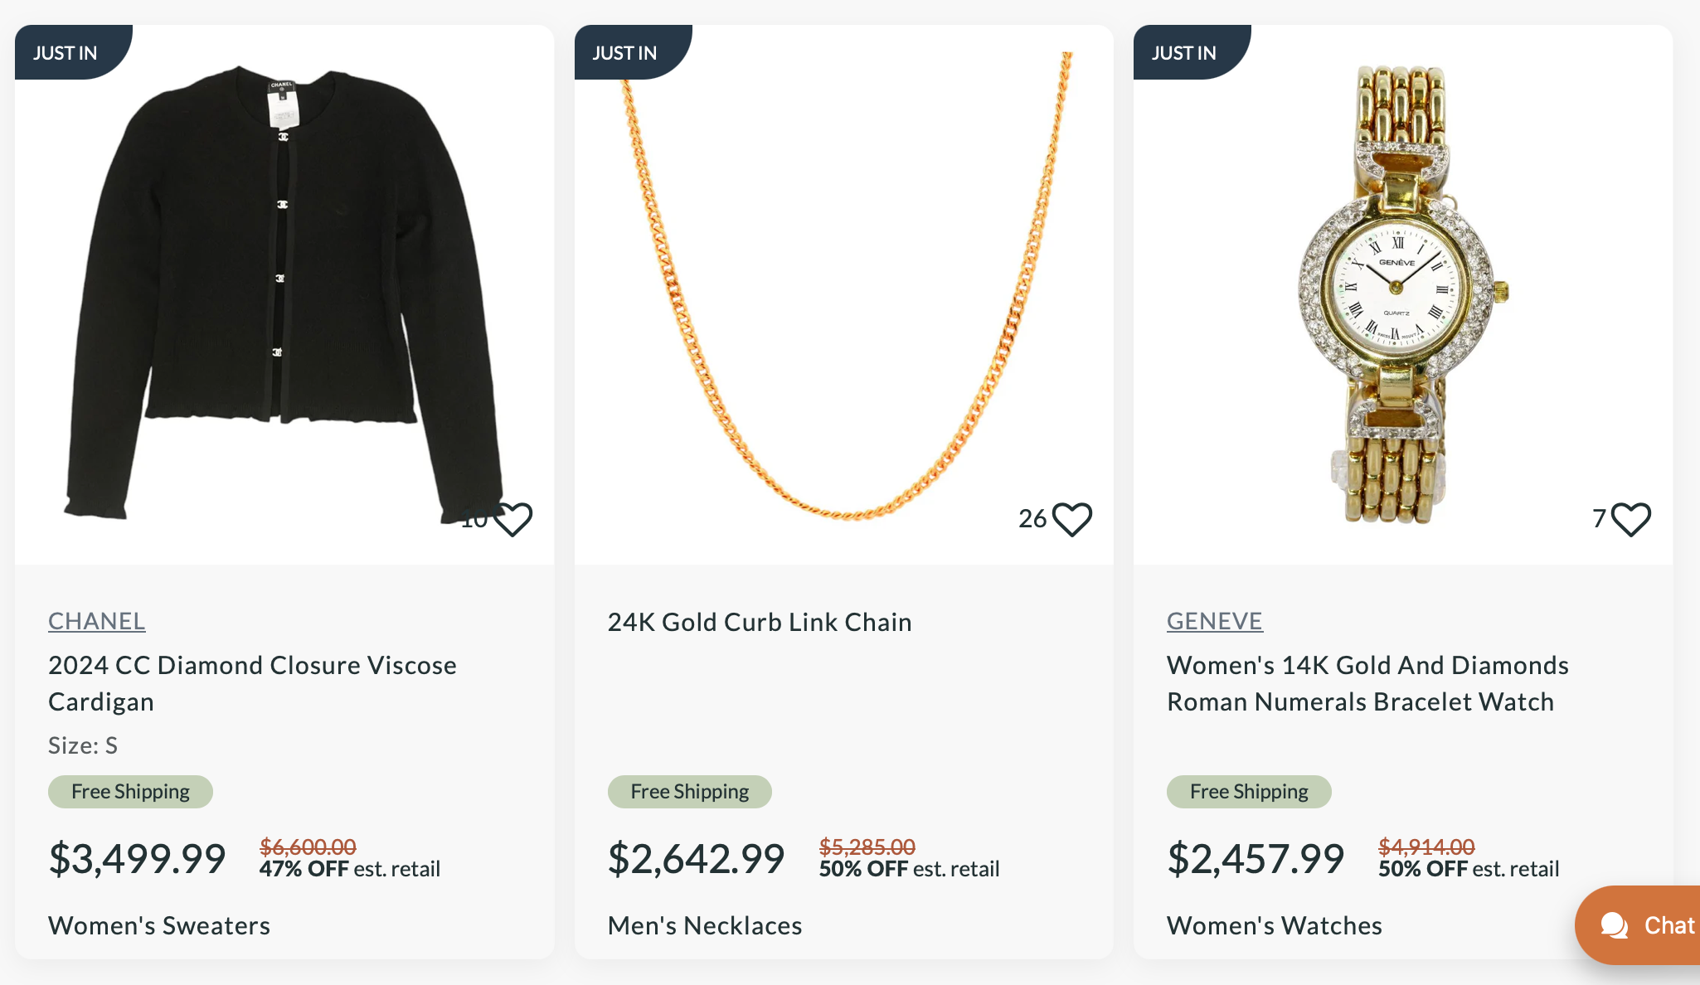
The Problem
> In 2023, 36.1 million mishandled bags.
Reasons:
UnclaimedBaggage.com - business built on the issue
of people losing their luggage.
Transfer mishandling – 46%;
Failure to load – 16%;
Ticketing error/bag switch/security/other – 14%;
Airport/customs/weather/space-weight restrictions – 8%;
Loading error – 8%;
Arrival mishandling – 4%;
Tagged error – 4%.

Slide 3


the solution
> A Traveler Platform
A photo of their luggage
A photo of their boarding pass
Geo-tag tracking
Travelers upload:
> Blockchain records it securely- travelers stay in control

Slide 4


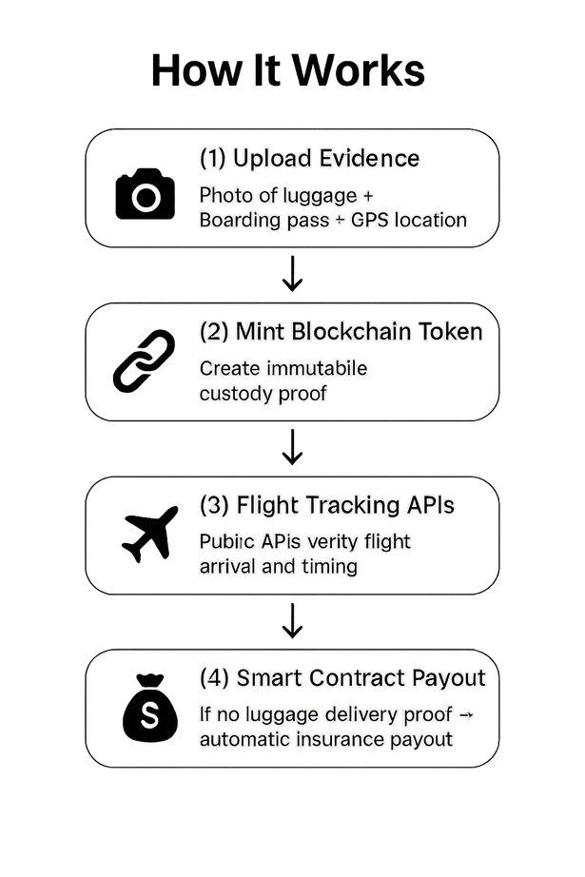


Real Example:
Leon checks in his suitcase at JFK
He uploads a photo and boarding pass through BagBlock.
His bag was lost during a transfer
BagBlock automatically submits his claim and flags his bag as missing without him needing to fight with the airline.

Slide 5

How do we charge
> The App is FREE
TRAVELERS PAY A SMALL FEE TO GET AUTOMATIC PAYOUT IF THE LUGGAGE GOES MISSING
OR $20/YEAR OPTIONAL UPGRADE FOR THOSE WHO TRAVEL OFTEN - COVERS ALL TRIPS
BOTH COVER:
AUTOMATIC SMART CONTRACT PAYOUTS IF LUGGAGE IS LOST
CLAIM FILING SERVICE IF SOMETHING GOES WRONG
CUSTODY PROOF

Slide 6



Who we partner with & why
Airlines First- Maybe Travel Insurance Later
Airlines scan and track all baggage
They are responsible when bags get lost
BagBlock helps them:
Track bags more accurately with time-stamped proof
Handle claims faster
Offer BagBlock to passengers as a booking add-on
Travel Insurance could be a future partnership
Useful for high-value or international claims
But our main focus is airlines-because they handle the baggage from start to finish

Slide 7

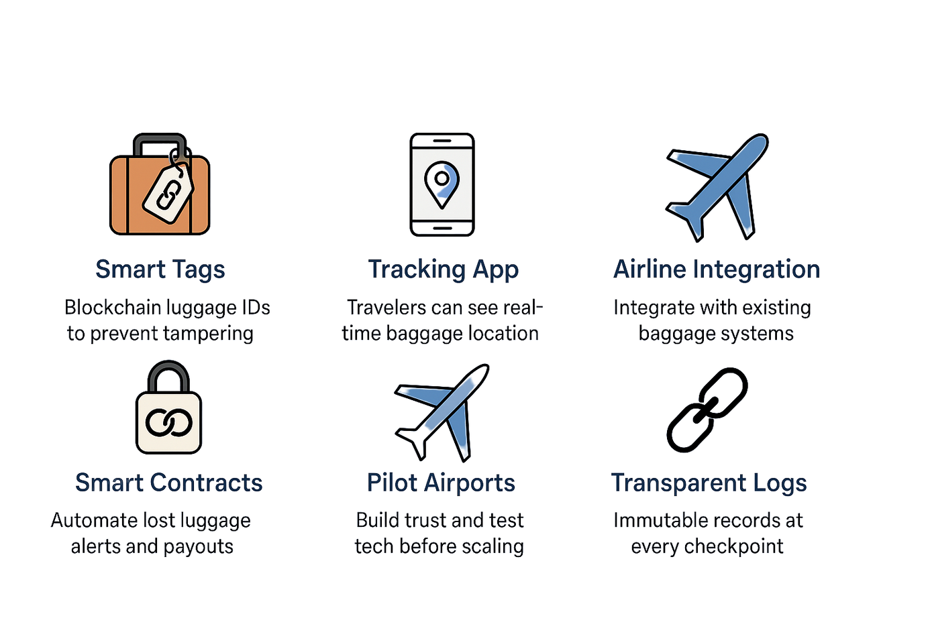

Fraud Prevention

Slide 8






Advanced Security
Biometric Access for Baggage Retrieval
Encrypted Tag Communications
Use facial or fingerprint verification at pickup
Transmit over secure, encrypted channels
Al-powered Anomaly Detection
Audit Trails for Insurance Claims
Identify unusual baggage patterns or movements
Generate logs for faster claim procesing

Slide 9

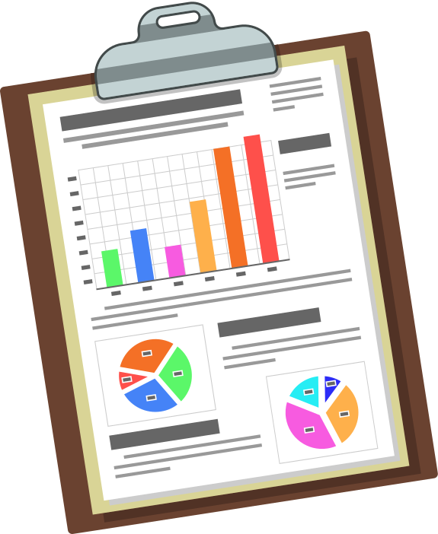



Risks and Challenges
AIRLINE COOPERATION
DATA PRIVACY COMPLIANCE
CROSS JURISDICTION LEGAL ISSUES
SCALABILITY

Slide 10
Impact
INCREASED TRUST AMONG PASSENGERS
LOWER ADMINISTRATIVE COSTS
BETTER EXPERIENCE FOR BOTH CUSTOMERS AND AIRLINES

Slide 11
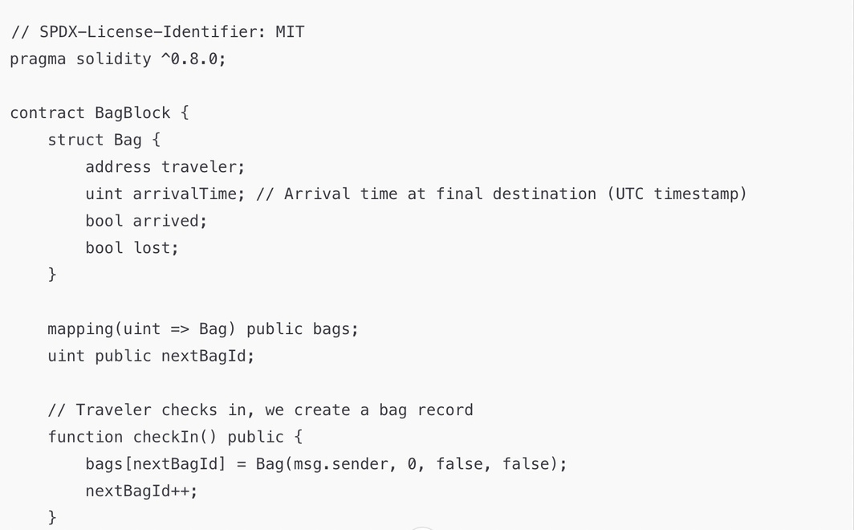
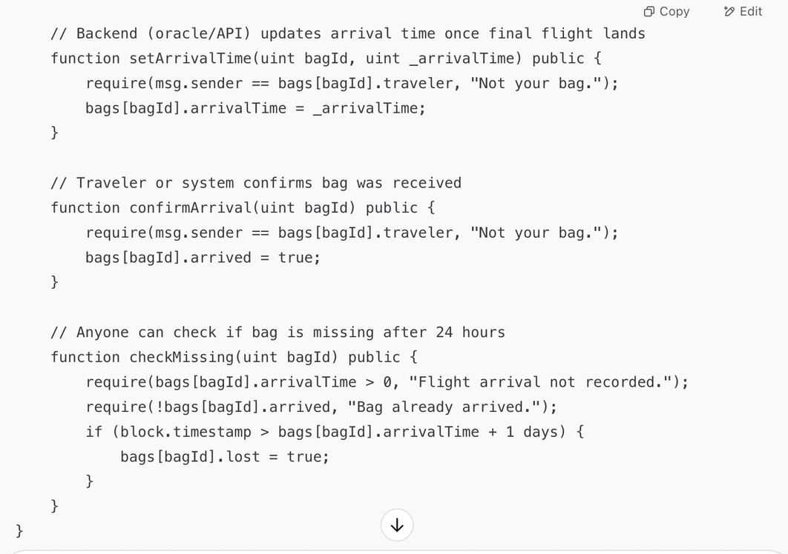
Coding
This contract tracks when a traveler’s flight arrives at its destination. If the bag’s reception isn’t confirmed after a day of the flight’s arrival, it is flagged as lost, which triggers a payout.

Slide 12

Thank You

